Slide 1
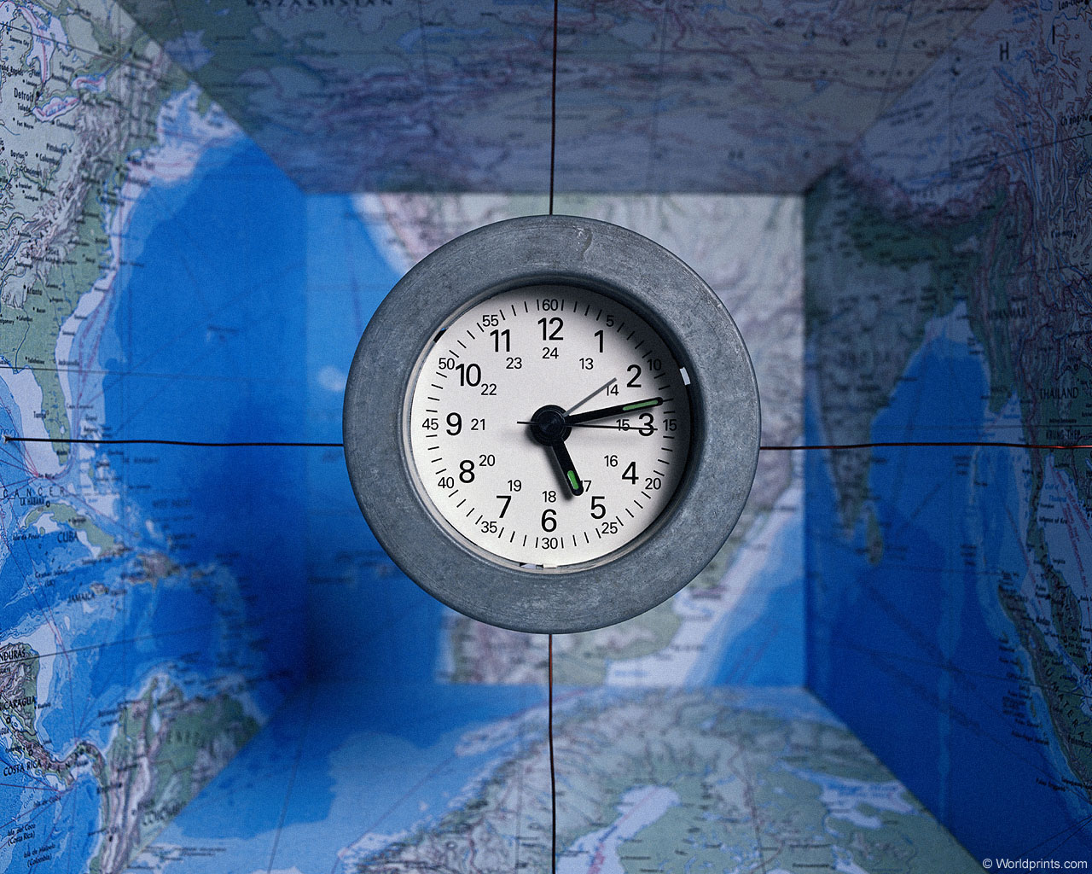
JEOPARDY
Great Britain!
Учитель: Васильева О.Д.
10-11 класс
Start

Slide 2
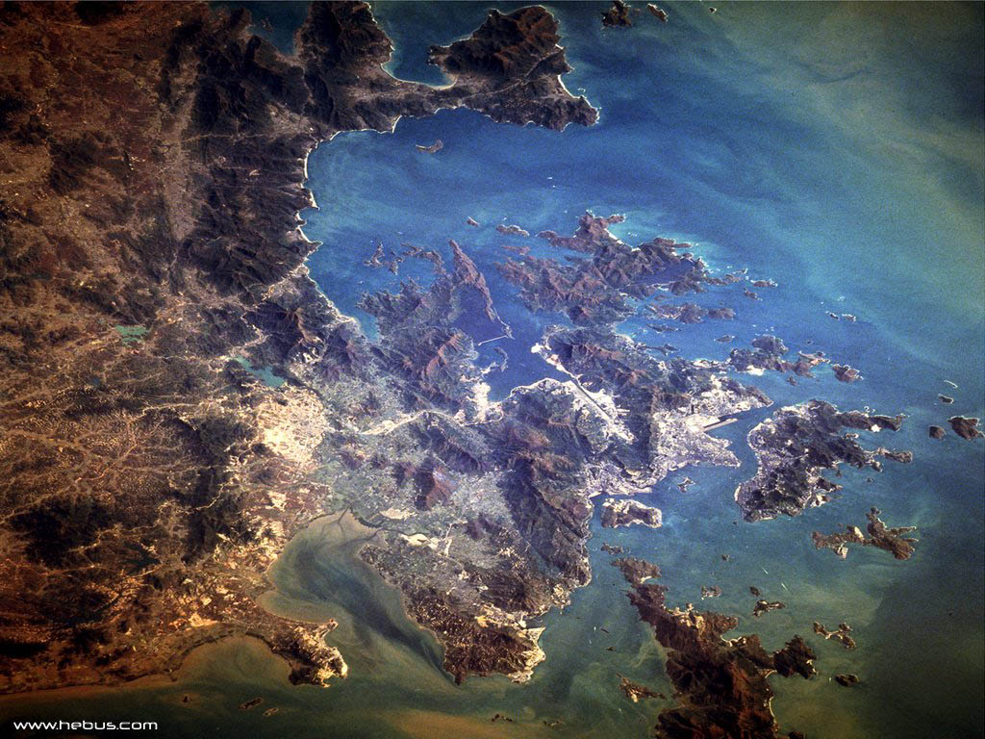
2
JEOPARDY!
THE UNITED KINGDOM
Customs and traditions
Food and drink
British and American English
Interesting places
100
ROUND 1
100
100
100
100
200
200
200
200
200
300
300
300
300
300
400
400
400
400
400
500
500
500
500
500

Slide 3
3
JEOPARDY!
Sport and transport
Education
Politics
Australia
Grammar
200
ROUND 2
200
200
200
200
400
400
400
400
400
600
600
600
600
600
800
800
800
800
800
1000
1000
1000
1000
1000

Slide 4
JEOPARDY!
ROUND 3
300
600
900
1200
1500
The end…

Slide 5
JEOPARDY!
THE UNITED KINGDOM
100
What is the difference between the United Kingdom and Great Britain?
Back

Slide 6
JEOPARDY!
THE UNITED KINGDOM
200
What is the capital of UK?
Back

Slide 7
JEOPARDY!
THE UNITED KINGDOM
300
How many parts are there in UK? What are their capitals?
Back

Slide 8
JEOPARDY!
THE UNITED KINGDOM
400
Which flag isn’t represented in the Union Flag?
Back

Slide 9
JEOPARDY!
THE UNITED KINGDOM
500
A PIG IN A POKE
Who are the most popular British writers? (name 5 of them)
Back

Slide 10
JEOPARDY!
Customs and traditions
100
What is the most popular English holiday?
Back

Slide 11
JEOPARDY!
Customs and traditions
200
What do people celebrate on the 14th of February?
Back

Slide 12
JEOPARDY!
Customs and traditions
300
When is Christmas?
Back

Slide 13
JEOPARDY!
Customs and traditions
400
What are the Britain's national flowers?
Back

Slide 14
JEOPARDY!
Customs and traditions
500
What is Guy Fawkes Night?
Back

Slide 15
JEOPARDY!
Food and drink
100
What is the most popular drink in Britain? What do the people like to drink it with?
Back

Slide 16
JEOPARDY!
Food and drink
200
A PIG IN A POKE
Who is the author of Harry Potter?
Back

Slide 17
JEOPARDY!
Food and drink
300
How often do they have a meal?
Back

Slide 18
JEOPARDY!
Food and drink
400
What is traditional Christmas meal?
Back

Slide 19
JEOPARDY!
Food and drink
500
What is the difference between can and tin?
Back

Slide 20
JEOPARDY!
British and American English
100
Квартира
Back

Slide 21
JEOPARDY!
British and American English
200
Почтовый ящик
Back

Slide 22
JEOPARDY!
British and American English
300
Фамилия
Back

Slide 23
JEOPARDY!
British and American English
400
Такси
Back

Slide 24
JEOPARDY!
British and American English
500
Консервная банка
Back

Slide 25
JEOPARDY!
Interesting places
100
Why is Big Ben so called?
Back

Slide 26
JEOPARDY!
Interesting places
200
What is Stonehenge?
Back

Slide 27
JEOPARDY!
Interesting places
300
Auction
What is Baker Street famous for?
Back

Slide 28
JEOPARDY!
Interesting places
400
What is the Tower of London?
Back

Slide 29
JEOPARDY!
Interesting places
500
What is Speaker's corner?
Back

Slide 30
JEOPARDY!
Sport and transport
200
What is the double-decker?
Back

Slide 31
JEOPARDY!
Sport and transport
400
What is public transport called?
Back

Slide 32
JEOPARDY!
Sport and transport
600
What is the most popular English sport?
Back

Slide 33
JEOPARDY!
Sport and transport
800
What is the most popular British airport?
A PIG IN A POKE
Back

Slide 34
JEOPARDY!
Sport and transport
1000
When did the Olympic Games take place in London?
Back

Slide 35
JEOPARDY!
Education
200
At what age do children go to school in Britain?
Back

Slide 36
JEOPARDY!
Education
400
What are 2 main British Universities?
Back

Slide 37
JEOPARDY!
Education
600
What is GCSE?
Back

Slide 38
JEOPARDY!
Education
800
What is the sport competition between Oxford and Cambridge students?
Back

Slide 39
JEOPARDY!
Education
1000
What is one of the most interesting facts about Cambridge University?
Back

Slide 40
JEOPARDY!
Politics
200
The name of the queen.
Back

Slide 41
JEOPARDY!
Politics
400
Tell the name of Prime Minister of GB? What's his address?
Back

Slide 42
JEOPARDY!
Politics
600
How many houses are there in the British Parliament? What are they?
Back

Slide 43
JEOPARDY!
Politics
800
Who in the royal family died in the car crash in 1997?
Back

Slide 44
JEOPARDY!
Politics
1000
What is the surname of the royal family?
Back

Slide 45
JEOPARDY!
Australia
200
What is the capital of Australia?
Back

Slide 46
JEOPARDY!
Australia
400
Who are the Australian natives?
Back

Slide 47
JEOPARDY!
Australia
600
Australia is not a(n)
Country
Island
City
Continent
Back

Slide 48
JEOPARDY!
Australia
800
When did the Europeans settle in Australia?
Back

Slide 49
JEOPARDY!
Australia
1000
Which two animals can you see on the Australian coat of arms?
Back

Slide 50
JEOPARDY!
Grammar
200
Put the sentence into indirect speech:
He said: “Why didn’t you buy any flowers?”
Back

Slide 51
JEOPARDY!
Grammar
400
Form the past perfect passive of the verb – to translate
Back

Slide 52
JEOPARDY!
Grammar
600
In which case we don’t use – to-
I expect you be on time.
I make him learn this.
Back

Slide 53
JEOPARDY!
Grammar
800
The order of adjectives in the sentence.
Back

Slide 54
JEOPARDY!
Grammar
1000
What is the name of Queen's husband?
Auction
Back

Slide 55
JEOPARDY!
Final question
300
When does England have national day?
Back

Slide 56
JEOPARDY!
Final question
600
What is Pancake Day?
Back

Slide 57
JEOPARDY!
Final question
900
When did Queen Victoria rule?
Back

Slide 58
JEOPARDY!
Final question
1200
What are the parks of London?
Back

Slide 59
JEOPARDY!
Final question
1500
Who is next in line to the British crown after Prince Charles?
Back

Slide 60
JEOPARDY
THANK YOU FOR the game!!!
GOOD BYE

